Slide 1
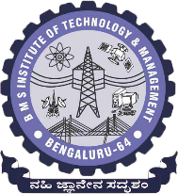
 | BMS INSTITUTE OF TECHNOLOGY & MANAGEMENT, YELAHANKA, BANGALORE. Department of Computer Science & Engineering
HAND GESTURE RECOGNITION FOR HUMAN COMPUTER INTERACTION (HCI)
ABHISHEK B – 1BY15CS005
Kanya krishi - 1BY15CS035
MEGHANA M - 1BY15CS049
MOHAMMED DAANIYAAL - 1BY15CS051
Under the guidance of:
DR.ANUPAMA HS
ASSOCIATE PROFESSOR, CSE
BMSIT&M

Slide 2
abstract
Hand gesture recognition is to interpret the human gestures using certain mathematical algorithms for computer interaction. They are widely used in gaming, media player control, robot control etc. It enables the humans to interact with the machine directly without any means of mechanical devices thereby improving the work efficiency of the machine used.
In our project hand gestures are used to train the model and perform certain actions like scrolling down a page, scrolling up a page, zooming in, and zooming out. The gestures are recorded in real time and sent to the model trained using convolutional neural networks (CNN) which sorts the gestures and maps them to their corresponding actions. PyAutoGUI is used to control the PDF or book using the commands that are generated based on the respective hand gestures made.

Slide 3
introduction
Gestures are the actions that commonly originate from any bodily motion, but usually they can be originated from the face or the hand. These gestures are helpful in communicating meaningful messages by the user. A hand gesture recognition system can be developed in order to capture the hand gestures that are being performed by the user, analyse them further to control the system based on the information gained from the analysis.
The hand gesture recognition system for human computer interaction uses OpenCV for gesture recognition and Convolutional neural network (ConvNets or CNNs) for training the model in use. It takes in gestures such as the palm for zooming in, the fist for zooming out, a swing of the hand turns the pages towards the right and the peace sign turns the pages towards the left.

Slide 4
OBJECTIVE
The main objective of our proposed system is to detect hand movements / gestures.
Detect the gestures by training the system on a dataset using neural networks and machine learning techniques.
Perform different actions such as switching of pages, zooming in or zooming out of pages, etc based on different gestures detected.
Perform the actions without interaction with the physical hardware such as keyboard and mouse.

Slide 5
SYSTEM REQUIREMENTS SPECIFICATION
FUNCTIONAL REQUIREMENTS:
Functional requirements are the necessary requirements for functioning of a software or a system. Functional requirements required for this system are –
Hand Detection
Background Subtraction
Hand Segmentation
Gesture Recognition and Prediction
Performing actions according to the recognised gesture on the pdf.
NON – FUNCTIONAL REQUIREMENTS:
Non – Functional requirements support the functioning of the system. They have a check on the entire system as a whole. Non – functional requirements of the system are:
Reliability: How reliable is the system to deliver the system its service.
Safety: The ability of the system to perform without failure.
Availability: The ability of the system to render its services at all times whenever requested by the user.
Dependability: This is a property of a software / system that establishes a confidence about the system to the user.
Security: The system is secure such that no outside attacker can intercept the system

Slide 6
SYSTEM REQUIREMENTS SPECIFICATION (CONTD.)
HARDWARE REQUIREMENTS:
Web Camera: 10 Megapixels or higher
Processor: Intel Core i5 or higher
Graphical Processing Unit (GPU): 4 GB
Memory: 25 GB Disk Space
SOFTWARE REQUIREMENTS:
Programming Language : Python 3.6
Operating System : Windows / Linux / Mac OS.
Anaconda : Anaconda is a free and open-source distribution of the Python and R programming languages for scientific computing, that aims to simplify package management and deployment.
Integrated Development Environment (IDE) : Spyder 3.3.4
OpenCV : A real time computer vision library.
NumPy : Python package for scientific computing.
Scikit - learn: Python library for machine learning.
TensorFlow : is a free and open-source software machine learning library.
TFlearn : is a modular and transparent deep learning library built on top of Tensorflow.
PyAutoGUI : PyAutoGUI is a cross-platform GUI automation Python module for human beings. Used to programmatically control the mouse & keyboard.

Slide 7
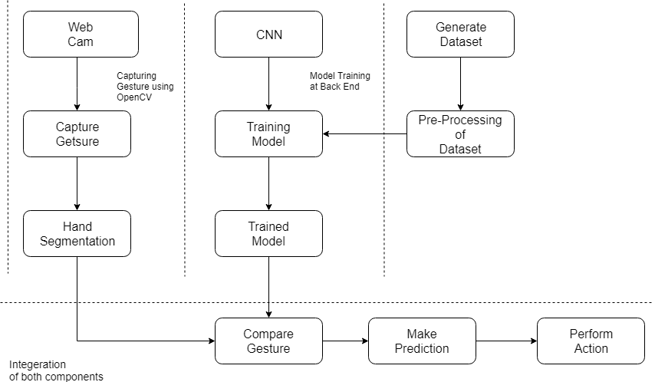
System design
Architectural Design
There are 2 essential components involved in this project: the OpenCV part to detect the hand gesture and the neural network(CNN) to train the model. Before training the model, the dataset should be pre-processed by carrying out actions such as background subtraction and resizing. Finally the hand is segmented from the captured gesture and the prediction is made using the trained model. Once the prediction is made, the necessary action is performed at real time.

Slide 8
2. Data Flow Diagram (DFD)
A Data Flow Diagram (DFD) is a graphical representation of the flow of data through an information system.
Level 0 DFD
The Level 0 DFD is a basic diagram that shows main the system in the model developed, the inputs and outputs that are required and expected. The DFD shows the system used – Hand Gesture Recognition System, the input – Hand movement and the output – Action performed.
Level 1 DFD
The level 1 DFD shows the various modules in the system developed. There are three main modules in our system – Capture Gesture, Predict Gesture and the Human Computer interaction. The Capture Gesture and Predict Gesture modules capture the frame and predict the gesture, the predicted gesture is then sent to the HCI module .The Human Computer Interaction module is used to generate commands that will control the PDF and perform corresponding actions.

Slide 9
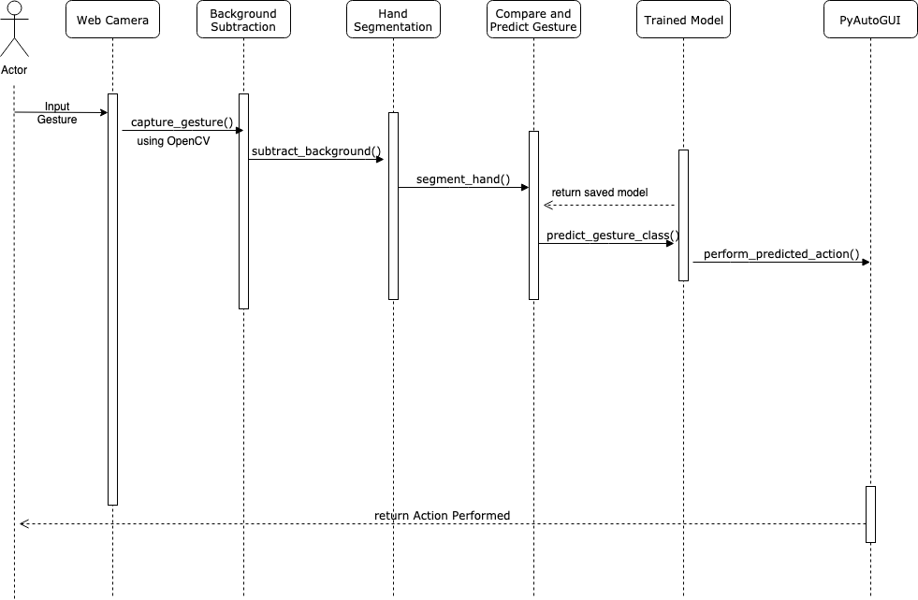
3. Sequence Diagram
The actor (the user) performs some action which will then be detected by OpenCV. Then background subtraction is applied to the captured frame and from that the hand is segmented. The detected hand gesture is then compare with the trained model which is generated on running the model trainer. The prediction is made and finally the action is performed by integrating PyAutoGUI.

Slide 10
LITERATURE SURVEY
SL.NO | AUTHOR, TITLE AND YEAR OF PUBLICATION | METHODOLOGY | ADVANTAGES | LIMITATIONS
1. | Meenakshi Panwar, Pawan Singh Mehra, Hand Gesture Recognition for Human Computer Interaction. | The implementation is divided into four main steps: 1.Image Enhancement and Segmentation 2.Orientation Detection 3.Feature Extraction 4.Classification | The proposed and implemented algorithm does not require any kind of training of sample data. It takes a less computation time as compare to other approaches. | Its main limitation is that different light condition leads to change of colors very rapidly, which may cause error or even failures.
2. | Rafiqul Zaman Khan and Noor Adnan Ibraheem, Comparitive Study Of Hand Gesture Recognition System. | Three main steps in this system 1. Segmentation 2. Feature Representation 3.Recognition Techniques It has an accuracy of 85.83%. | Recognises gestures from both 2D and 3D images. Different groups of features are examined to decide the good performance group. | It doesn’t consider motion gestures. It is unable to classify images with complex background The computation time is high(2-4s).
3. | Arpita Ray Sarkar G. Sanyal , S. Majumder Hand Gesture Recognition Systems: A Survey. | The phases are: 1.Data acquisition, 2.Hand segmentation and pre-processing, 3.Feature extraction and finally 4.the recognition. | It provides a brief description of all the gesture modelling algorithms used. Lists the various input and sensor devices available. | When there is a change in the illumination condition, the system fails to recognize properly The system fails to recognize if the hand is orientated in a different angle. Special hardwares are required

Slide 11
SL.NO | AUTHOR, TITLE AND YEAR OF PUBLICATION | METHODOLOGY | ADVANTAGES | LIMITATIONS
4. | Manjunath A E, Vijaya Kumar B P, Rajesh H Comparative Study of Hand Gesture Recognition Algorithms. | The phases are: 1.Hand gesture recognition using kinect camera 2.Edge Detection 3.Hand Gesture recognition. | This system captures the gestured image and compares it with the predefined images in the database. On finding a match, it outputs the number which the gesture signifying. | The edge detection and segmentation algorithms used here are not very efficient when compared to neural networks. The dataset is very small . The histogram matching method is not very reliable and can give false output at times.
5. | Dnyanada R Jadhav, L. M. R. J Lobo, Navigation of PowerPoint Using Hand Gestures. | The System architecture consists of 1.Image acquisition 2.Segmentation of hand region. 3.Distance transform method for gesture recognition. | 1.Distance transform method is better in performance than circular profiling method. 2.The presented gesture recognition system recognizes both static and dynamic gestures. | The limitations are: 1.The number of gestures that are recognized are less. 2.The gestures where not used to control any applications.
6. | Ruchi Manish Gurav Premanand K. Kadbe, Real time Finger Tracking and Contour Detection for Gesture Recognition using OpenCV. | Algorithms used are: 1.Viola and jones Algorithm. 2.Convex Hull Algorithm. 3. The AdaBoost based learning Algorithm. | The work was accomplished by training a set of feature set which is local contour sequence. The advantage of Local contour sequence is that it is invariant to rotation, translation and Scaling. We have achieved 92% accuracy with Convex Hull and 70% accuracy with AdaBoost. | It requires two sets of images for classification. One is the positive set that contains the required images. The other is the negative set that contains contradicting images.
7. | Pei Xu, A Real-Time Hand Gesture Recognition and Human Computer Interaction System. | The system consists of 1.Hand detection 2.Gesture recognition 3.Human-Computer Interaction (HCI) | The system uses CNN with accuracy rate of 99% It uses only one Monocular camera to capture the image. | The system recognizes only static images. The CNN used is not reliable since the number of images used to train and test the classifier is less. It only recognizes a gesture and not a motion.

Slide 12
IMPLEMENTATION
Integrated Development Environment (IDE)
Anaconda is a free and open-source distribution of the Python and R programming languages for scientific computing (data science, machine learning applications, large-scale data processing, predictive analytics, etc.), that aims to simplify package management and deployment. Package versions are managed by the package management system conda.
Spyder is an open source cross-platform integrated development environment (IDE) for scientific programming in the Python language. Spyder integrates with a number of prominent packages in the scientific Python stack, including NumPy, SciPy, Matplotlib, pandas, IPython, SymPyand Cython, as well as other open source software.
2. Programming Language, Tools and Data Structures
Python 3.6
Python is an interpreted, high-level, general purpose programming language. It provides constructs that enable clear programming on both small and large scales. Python is commonly used in artificial intelligence projects with the help of various libraries. As a scripting language with modular architecture, simple syntax and rich text processing tools, Python is often used for natural language processing.

Slide 13
IMPLEMENTATION (CONTD.)
Tools:
OpenCV: OpenCV (Open Source Computer Vision Library) is an open source computer vision and machine learning software library. OpenCV is a cross-platform library using which we can develop real-time computer vision applications. It mainly focuses on image processing, video capture and analysis including features like face detection and object detection.
NumPy: is the fundamental package for scientific computing in Python. It provides routines for fast operations on arrays, including mathematical, logical, selecting, I/O, discrete Fourier transforms, basic linear algebra, basic statistical operations, random simulation and much more.
TensorFlow: TensorFlow is a free and open-source software library for dataflow and differentiable programming across a range of tasks. It is a symbolic math library, and is also used for machine learning applications such as neural networks. It is used for both research and production at Google.
PyautoGUI: PyAutoGUI is cross-platform GUI automation module that works on Python 2 and 3. You can control the mouse and keyboard as well as perform basic image recognition to automate tasks on your computer.

Slide 14
IMPLEMENTATION (CONTD.)
Data Structures:
NumPy arrays: NumPy arrays have a fixed size at creation. Changing the size of an array will create a new array and delete the original. It facilitates advanced mathematical and other types of operations on large numbers of data. Typically, such operations are executed more efficiently and with less code than is possible using Python’s built-in sequences.
Python dictionaries: in Python is an unordered collection of data values, used to store data values as a key value pair.
Python lists: is used to store multiple data at the same time. The list in Python are ordered and have a definite count. The elements in a list are indexed.

Slide 15
IMPLEMENTATION (CONTD.)
3. Algorithm
• The CNN is designed using TensorFlow.
• The network contains 1 input layer, 7 hidden convolution layers with Relu as the activation function and 1 Fully connected layer.
• The model is trained using this network for four gestures.
• The gesture is captured using a webcam and is pre-processed.
• This gesture is compared to the trained model and a prediction is made.
• This prediction is used to perform actions using PyAutoGUI.

Slide 16
IMPLEMENTATION (CONTD.)
4. Functions
resizeImage():
This function s used in order to resize the images so that it can be fed into the Convolution Neural Network designed using tensorflow. The network accepts 89 x 100 dimensional image.
run_avg():
This function is used to initialize the background. The weighted average is computed, accumulated and the background is updated.
segment():
The absolute difference between the background and current frame is computed. This difference is used to calculate the threshold in order to get the foreground. The contours in this thresholded image are computed and the contour area is calculated. Based on the contour area, the maximum contour area is found and this is recognized as the hand.
getPredictedClass():
This function is used to make the prediction based on the gesture captured in the frame. The prediction is made by using the model that is loaded from the ModelTrainer file. The predicted class and the confidence are returned as a tuple.

Slide 17
IMPLEMENTATION (CONTD.)
showStatistics():
This function is used to display a window to show the predicted gesture along with the confidence with which the gesture is predicted as a percentage.
main():
This is the main function which calls the other functions and runs the program.
5. Walkthrough of the project
i. Generation of dataset:
The dataset is generated by running the PalmTrack.py file. On running this file, a window is opened for capturing the gesture being shown. The background is subtracted and the Region Of Interest (ROI) is converted to grayscale and blurred.
On pressing ‘s’, the window starts capturing the images of the gesture being shown. For each gesture there are two folders being created i.e training-set and test-set. A set of 1000 images are captured for the training-set and a set of 100 images are captured for the test-set.
ii. Resizing of Images:
The resizeImage() function resizes the images in the dataset suitably in order to feed it into the neural network. The network accepts only images of size 89*100 pixels.

Slide 18
IMPLEMENTATION (CONTD.)
iii. Training the model using Convolutional Neural Network (CNN):
The CNN is designed using tensorflow. Once the dataset is prepared, it is fed into this network for training. The network contains 1 input layer, 7 hidden convolution layers with Relu as the activation function and 1 Fully connected layer. It is trained across 50 iterations with a batch size of 64. The model achieves an accuracy of 99.94% on the training dataset and 92% on test dataset. The ratio of training set to validation set is
1000 : 100. Once the model is trained, it is saved as a tfl file. This file is loaded at run time and used to predict the gesture.
iv. Running the Project:
Running the run.py file opens up your webcam and takes continuous frames of your hand image and then predicts the class of your hand gesture in realtime.
On running the project, there are 3 windows that open i.e the thresholded window displaying the captured frames after background subtraction, the video feed displaying the frame with a green rectangle indicating the region of interest (roi) and the Statistics window to display the name of the predicted gesture and the confidence level.

Slide 19
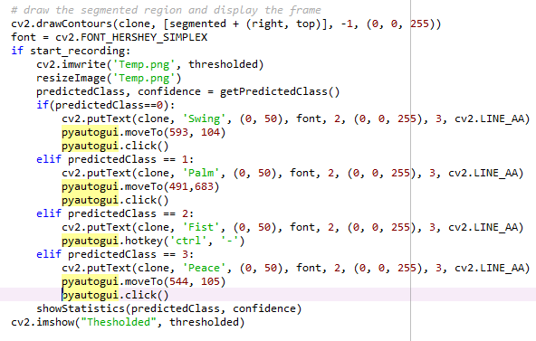
IMPLEMENTATION (CONTD.)
The gestures indicate the following:
Palm is used for performing zoom in operation at runtime.
Fist is used for performing zoom out operation at runtime.
Swing is used for performing turning right operation at runtime.
Peace is used for performing turning left operation at runtime.
Now that the gestures are being detected, this output is used to perform certain real time applications. PyAutoGUI is linked here and thus actions such as zooming in , zooming out, turning the pages are performed on a PDF file. The following image demonstrates the usage of PyAutoGUI in the code in order to perform the required actions:

Slide 20
TESTING
Testing is intended to show that a program does what it is intended to do and to discover program defects before it is put into use.
Unit testing is a level of software testing where individual units/components of a software are tested. The purpose is to validate that each unit of the software performs as required.
Integration testing (sometimes called integration and testing, abbreviated I&T) is the phase in software testing in which individual software modules are combined and tested as a group.
System testing is testing conducted on a complete integrated system to evaluate the system's compliance with its specified requirements. System testing takes, as its input, all of the integrated components that have passed integration testing.

Slide 21

TESTING (CONTD.)
Test Case Id | Description | Expected Result | Result
U_TC_001 | Loading the dataset | Load the images and the labels of the training and test dataset into python lists. | Pass
U_TC_002 | Training the convolutional neural network (CNN) and save the model, | Generate a model on the dataset trained and save a model file. | Pass
U_TC_003 | Gesture recognition and prediction | Capture the frame, recognise the gesture shown by the user in the region of user and predict it (right, left, zoom-in and zoom out). | Pass
I_TC_001 | Loading the dataset and Training the convolutional neural network (CNN) | The images loaded into the python lists to be used as input data to the convolutional neural network. | Pass
I_TC_002 | Loading the trained model, opening the web camera, drawing the region of interest, gesture recognition and prediction and PyAutoGUI | Load the saved model, draw a bounding box in the region of interest on the frame, recognise and predicted gesture is sent to the PyAutoGUI module to perform the corresponding action. | Pass
S_TC_001 | Zoom – in (Palm) | Zoom in of the page. | Pass
S_TC_002 | Zoom – out (Fist) | Zoom out of the page. | Pass
S_TC_003 | Right (Swing) | Turn the page right or switch to the next page. | Pass
S_TC_004 | Left (Peace) | Turn the page left or switch to the previous page. | Pass
S_TC_005 | Any random gesture | No action should be performed | Fail
Hand Gesture Recognition For Human Computer Interaction

Slide 22
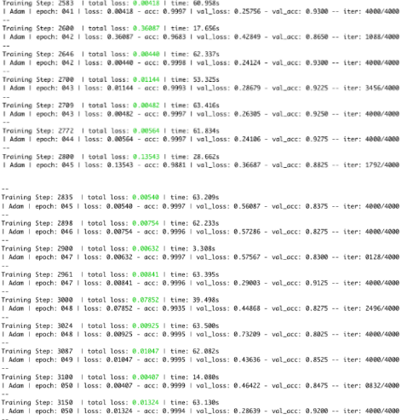
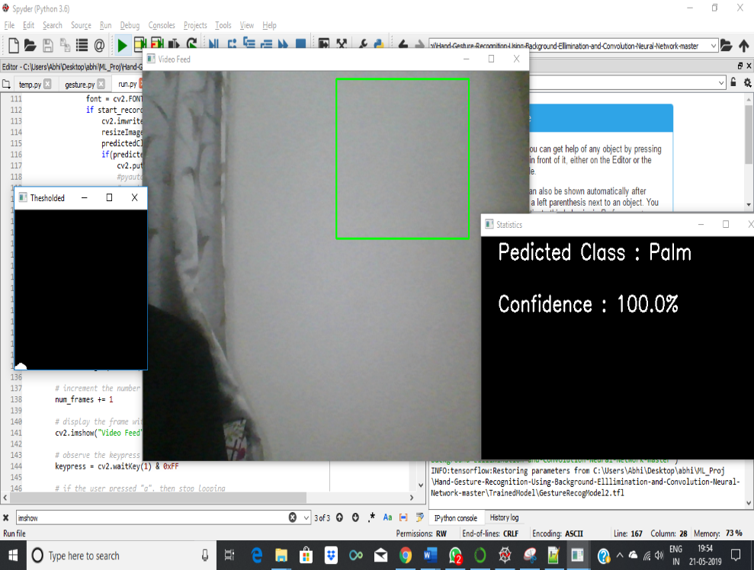
RESULTS AND ANALYSIS
The dataset was generated with background subtraction.
There are 1000 training images and 100 test images for each gesture.]
The model was trained for 50 epochs.
The model achieves an accuracy of 99.4% on the training dataset and an accuracy of 92% on the test dataset.
Training the model
Display of windows

Slide 23
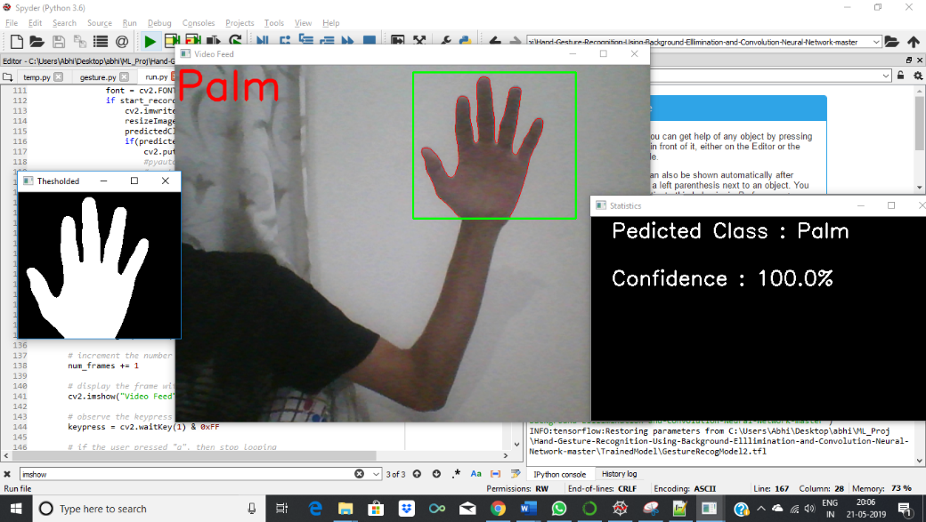
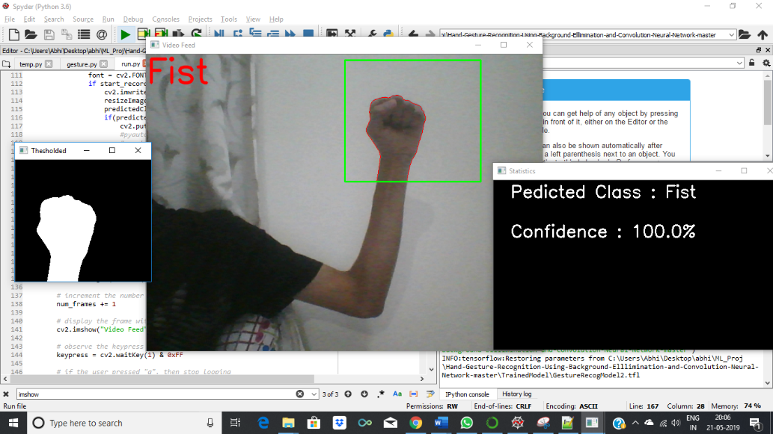
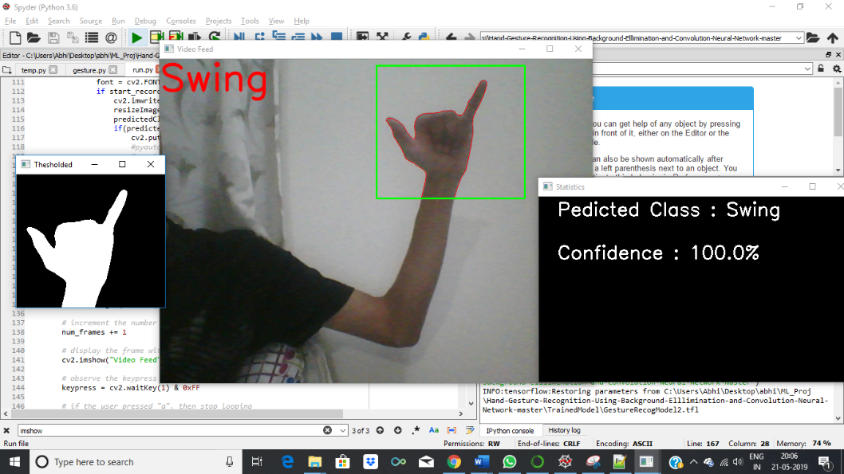
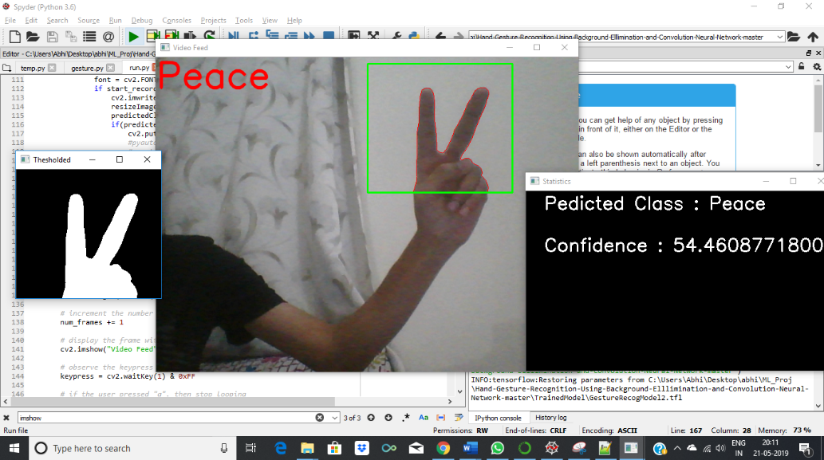
RESULTS AND ANALYSIS (CONTD.)
Prediction of Palm Gesture (Zoom In) Prediction of Fist Gesture (Zoom Out)
Prediction of Swing Gesture (Right) Prediction of Peace Gesture (Left)

Slide 24
CONCLUSION AND FUTURE ENHANCEMENT
This project demonstrates the usage of convolutional neural networks in hand gesture recognition using OpenCV.
The hand detection is done using Machine Learning techniques. The system is trained for four gestures using the generated dataset.
The proposed system is used to detect the hand gestures of a person and performing certain actions such as turning the page right and left, zooming in and zooming out in a PDF, etc.
The application of the project are in various areas such as :
Automated homes
Making presentations
Gaming
Switching T.V channels
Internet of Things (IOT)
As part of the future work and enhancement the following can be implemented :
More number of gestures
Extending to dynamic gestures such as swiping left and right
Better accuracy and efficiency
Moving through multiple pages

Slide 25
REFERENCES
[1] Meenakshi Panwar, Pawan Singh Mehra, Hand Gesture Recognition for Human Computer Interaction, International Conference on Image Information Processing India (2011).
[2] Rafiqul Zaman Khan and Noor Adnan Ibraheem, Comparitive Study Of Hand Gesture Recognition System, AIRCC Digital Library
[3] Arpita Ray Sarkar ,G. Sanyal , S. Majumder ,Hand Gesture Recognition Systems: A Survey ,International Journal of Computer Applications Volume 71– No.15, May 2013.
[4] Manjunath A E ,Vijaya Kumar B P , Rajesh H, Comparative Study of Hand Gesture Recognition Algorithms, International Journal of Research in Computer and Communication Technology, Vol 3, Issue 4, April- 2014.
[5] Dnyanada R Jadhav, L. M. R. J Lobo, Navigation of PowerPoint Using Hand Gestures , International Journal of Science and Research (IJSR) 2015.
[6] Ruchi Manish Gurav, Premanand K. Kadbe, Real time finger tracking and contour detection for gesture recognition using OpenCV, IEEE Conference May 2015, Pune India.
[7] Pei Xu, Department of Electrical and Computer Engineering, University of Minnesota, A Real-time Hand Gesture Recognition and Human-Computer Interaction System, Research Paper April 2017.
[8] P.Suganya, R.Sathya, K.Vijayalakshmi , Detection and Recognition of Gestures To Control The System Applications by Neural Networks, International Journal of Pure and Applied Mathematics 2018.

